Slide 1
ECE 441 Single Bus Step Cycle Practice Questions

Slide 2
Objective
Solve opcode and bus behavior when given instruction.

Slide 3
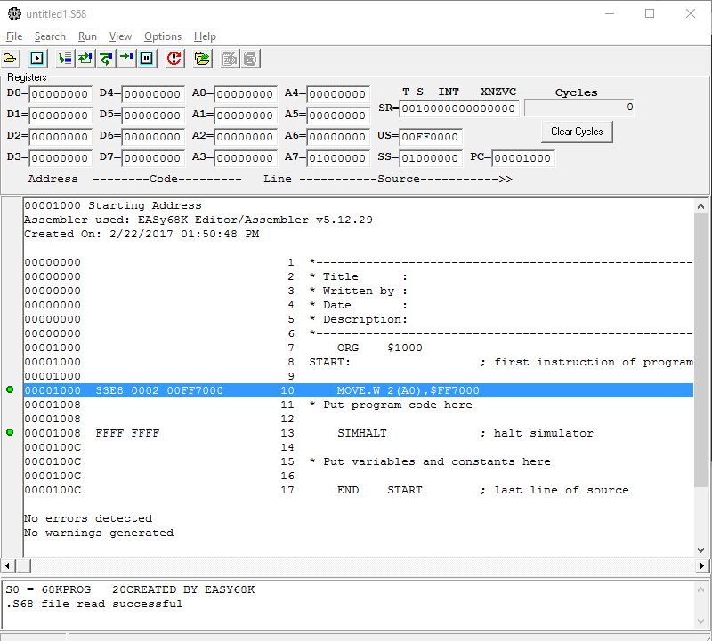

Slide 4
Instruction Format
Single Effective Address Operation Word One word, specifies operation and mode
Special Operand Specifiers If any, one or two words
Immediate Operand or Source Effective Address Extension If any, one to six words
Destination Effective Address Extension If any, one to six words
*M68000 FAMILY PROGRAMMER’S REFERENCE MANUAL P2-1

Slide 5
Effective Address
Address modes
Dn | d8(An,Xn)
An | (xxx).W
(An) | (xxx).L
(An)+ | d16(PC)
-(An) | d8(PC,Xn)
d16(An) | #<data>
*MC68000 EDUCATIONAL COMPUTER BOARD USER’S MANUAL P4-16

Slide 6
Effective Address
00000000
00007FFF
00008000
FFFF7FFF
FFFF8000
FFFFFFFF
Absolute short (XXX).W 16bits
Absolute long (XXX).L 32bits
Absolute short (XXX).W 16bits
0000 0000 0000 0000 0000 0000 0000 0000 0000 0000 0000 0000 0111 1111 1111 1111
0000 0000 0000 0000 1000 0000 0000 0000 1111 1111 1111 1111 0111 1111 1111 1111
1111 1111 1111 1111 1000 0000 0000 0000 1111 1111 1111 1111 1111 1111 1111 1111
*MC68000 EDUCATIONAL COMPUTER BOARD USER’S MANUAL P4-20

Slide 7
MOVE.L $7000,$B100
0 | 0 | Size | DESTINATION | SOURCE
0 | 0 | 1 0 | 0 0 1 1 1 1 | 1 1 1 0 0 0
23F8 7000 0000B100
Bus Cycle # | Address | Data
1 | A000 | 23F8 | 1 | 0 | 0 | 0 | 1 | 1 | 0
2 | A002 | 7000 | 1 | 0 | 0 | 0 | 1 | 1 | 0
3 | A004 | 0000 | 1 | 0 | 0 | 0 | 1 | 1 | 0
4 | A006 | B100 | 1 | 0 | 0 | 0 | 1 | 1 | 0
5 | 7000 | U | 1 | 0 | 0 | 0 | 1 | 0 | 1
6 | 7002 | U | 1 | 0 | 0 | 0 | 1 | 0 | 1
7 | B100 | U | 0 | 0 | 0 | 0 | 1 | 0 | 1
8 | B102 | U | 0 | 0 | 0 | 0 | 1 | 0 | 1

Slide 8
LEA +5(A3),A2
0 | 1 | 0 | 0 | Register | 1 1 1 | Effective Address
0 | 1 | 0 | 0 | 0 1 0 | 1 1 1 | 1 0 1 0 1 1
45EB 0005
Bus Cycle # | Address | Data
1 | A000 | 45EB | 1 | 0 | 0 | 0 | 1 | 1 | 0
2 | A002 | 0005 | 1 | 0 | 0 | 0 | 1 | 1 | 0

Slide 9
MOVE.L (A1),(A2)
0 | 0 | Size | DESTINATION | SOURCE
0 | 0 | 1 0 | 0 1 0 0 1 0 | 0 1 0 0 0 1
2491
Bus Cycle # | Address | Data
1 | A000 | 2491 | 1 | 0 | 0 | 0 | 1 | 1 | 0
2 | A100 | U | 1 | 0 | 0 | 0 | 1 | 0 | 1
3 | A102 | U | 1 | 0 | 0 | 0 | 1 | 0 | 1
4 | A200 | U | 0 | 0 | 0 | 0 | 1 | 0 | 1
5 | A202 | U | 0 | 0 | 0 | 0 | 1 | 0 | 1

Slide 10
CLR.L $A000
0 | 1 | 0 | 0 | 0 0 1 0 | Size | Effective Address
0 | 1 | 0 | 0 | 0 0 1 0 | 1 0 | 1 1 1 0 0 1
42B9 0000A000
Bus Cycle # | Address | Data
1 | A000 | 42B9 | 1 | 0 | 0 | 0 | 1 | 1 | 0
2 | A002 | 0000 | 1 | 0 | 0 | 0 | 1 | 1 | 0
3 | A004 | A000 | 1 | 0 | 0 | 0 | 1 | 1 | 0
4 | A000 | 42B9 | 1 | 0 | 0 | 0 | 1 | 0 | 1
5 | A002 | 0000 | 1 | 0 | 0 | 0 | 1 | 0 | 1
6 | A002 | 0000 | 0 | 0 | 0 | 0 | 1 | 0 | 1
7 | A000 | 0000 | 0 | 0 | 0 | 0 | 1 | 0 | 1

Slide 11
ROR (A2)+
1 | 1 | 1 | 0 | 0 | 1 | 1 | dr | 1 | 1 | Effective Address
1 | 1 | 1 | 0 | 0 | 1 | 1 | 0 | 1 | 1 | 0 1 1 0 1 0
E6DA
Bus Cycle # | Address | Data
1 | A000 | E6DA | 1 | 0 | 0 | 0 | 1 | 1 | 0
2 | A200 | U | 1 | 0 | 0 | 0 | 1 | 0 | 1
3 | A200 | U | 0 | 0 | 0 | 0 | 1 | 0 | 1

Slide 12
PEA -15(A2)
A2 → A200 -15 → FFF1 → FFFFFFF1
0 | 1 | 0 | 0 | 1 | 0 | 0 | 0 | 0 | 1 | Effective Address
0 | 1 | 0 | 0 | 1 | 0 | 0 | 0 | 0 | 1 | 1 0 1 0 1 0
486A FFF1
Bus Cycle # | Address | Data
1 | A000 | 486A | 1 | 0 | 0 | 0 | 1 | 1 | 0
2 | A002 | FFF1 | 1 | 0 | 0 | 0 | 1 | 1 | 0
3 | A6FE | A1F1 | 0 | 0 | 0 | 0 | 1 | 0 | 1
4 | A6FC | 0000 | 0 | 0 | 0 | 0 | 1 | 0 | 1
Calculates an effective address <ea> and pushes it onto the stack pointed to by address register A7 (the stack pointer, SP).

Slide 13
ADDI.L #$2,2(A2,A0)
DISPLACEMENT : 1000 0000 XXXX XXXX (X: DISPLACEMENT INTEGER) => 1000 0010 (8002)
FFFFA000
A200
+ 2
4202
0 | 0 | 0 | 0 | 0 | 1 | 1 | 0 | Size | Effective Address
0 | 0 | 0 | 0 | 0 | 1 | 1 | 0 | 1 0 | 1 1 0 0 1 0
06B2 00000002 8002
Bus Cycle # | Address | Data
1 | A000 | 06B2 | 1 | 0 | 0 | 0 | 1 | 1 | 0
2 | A002 | 0000 | 1 | 0 | 0 | 0 | 1 | 1 | 0
3 | A004 | 0002 | 1 | 0 | 0 | 0 | 1 | 1 | 0
4 | A006 | 8002 | 1 | 0 | 0 | 0 | 1 | 1 | 0
5 | 4202 | U | 1 | 0 | 0 | 0 | 1 | 0 | 1
6 | 4204 | U | 1 | 0 | 0 | 0 | 1 | 0 | 1
7 | 4204 | U | 0 | 0 | 0 | 0 | 1 | 0 | 1
8 | 4202 | U | 0 | 0 | 0 | 0 | 1 | 0 | 1

Slide 14
Understand Brief Extension Word
15 | 14 | 13 | 12 | 11 | 10 | 9 | 8 | 7 | 6 | 5 | 4 | 3 | 2 | 1 | 0
D/A | Register Number |  |  | W/L | 0 | 0 | 0 | Displacement Integer
D/A indicates the register used for indexing
0 for data register
1 for address register
W/L indicates the length for indexing (not operation)
0 for word indexing
1 for long indexing
*M68000 FAMILY PROGRAMMER’S REFERENCE MANUAL P2-21

Slide 15
Understand Word and Long Indexing
15 | 14 | 13 | 12 | 11 | 10 | 9 | 8 | 7 | 6 | 5 | 4 | 3 | 2 | 1 | 0
D/A | Register Number |  |  | W/L | 0 | 0 | 0 | Displacement Integer
Word indexing allow 16 bits for destination operant with sign extension
Long indexing allow 32 bits for destination operant(when .L is specified)
Example
Instruction | ADDI.L #2, 2(A2,A0) | ADDI.L #2,2(A2,A0.L)
Opcode | 06B2 00000002 8002 | 06B2 00000002 8802
Destination Operant | $A200+$FFFFA000+2 = $4202 Only 16 bits preserved | $A200+$A000+2 = $14202 All 32 bits preserved
*M68000 FAMILY PROGRAMMER’S REFERENCE MANUAL P2-10

Slide 16
BRA $3000
0 | 1 | 1 | 0 | 0 | 0 | 0 | 0 | 8 BIT DISPLACEMENT
0 | 1 | 1 | 0 | 0 | 0 | 0 | 0 | 0000 0000
6000 8FFE
Bus Cycle # | Address | Data
1 | A000 | 6000 | 1 | 0 | 0 | 0 | 1 | 1 | 0
2 | A002 | 8FFE | 1 | 0 | 0 | 0 | 1 | 1 | 0
$3000 XXXXXXX
$3000-$A002 = $8FFE
$A000 BRA $3000

Slide 17
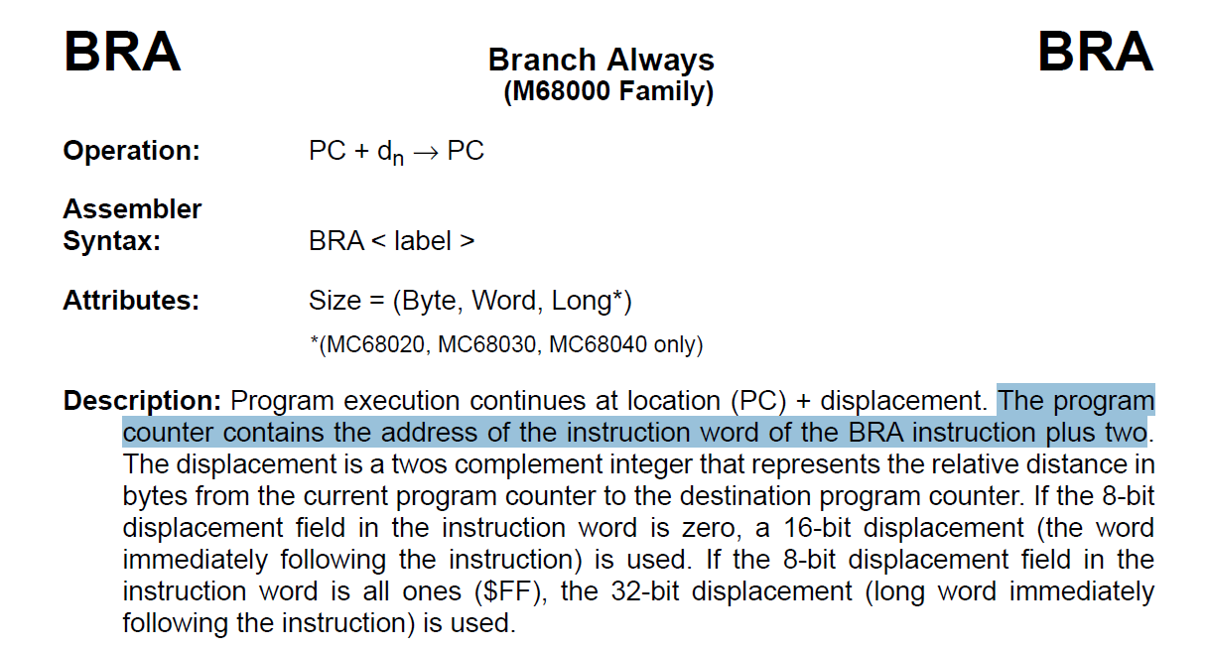

Slide 18
MOVEM.L (A3)+,A0/D0
0 | 1 | 0 | 0 | 1 | dr | 0 | 0 | 1 | Sz | Effective Address
Register List Mask
0 | 1 | 0 | 0 | 1 | 1 | 0 | 0 | 1 | 1 | 0 1 1 0 1 1
Register List Mask
4CDB 0101
A7 | A6 | A5 | A4 | A3 | A2 | A1 | A0 | D7 | D6 | D5 | D4 | D3 | D2 | D1 | D0
(A)+
D0 | D1 | D2 | D3 | D4 | D5 | D6 | D7 | A0 | A1 | A2 | A3 | A4 | A5 | A6 | A7
-(A)
Bus Cycle # | Address | Data
1 | A000 | 4CDB | 1 | 0 | 0 | 0 | 1 | 1 | 0
2 | A002 | 0101 | 1 | 0 | 0 | 0 | 1 | 1 | 0
3 | A300 | U | 1 | 0 | 0 | 0 | 1 | 0 | 1
4 | A302 | U | 1 | 0 | 0 | 0 | 1 | 0 | 1
5 | A304 | U | 1 | 0 | 0 | 0 | 1 | 0 | 1
6 | A306 | U | 1 | 0 | 0 | 0 | 1 | 0 | 1

